Slide 1
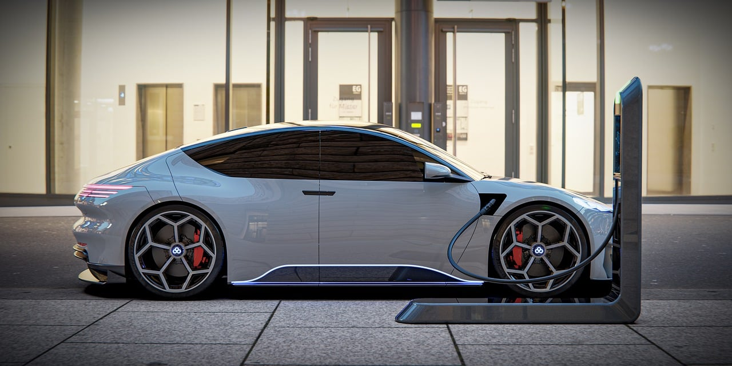
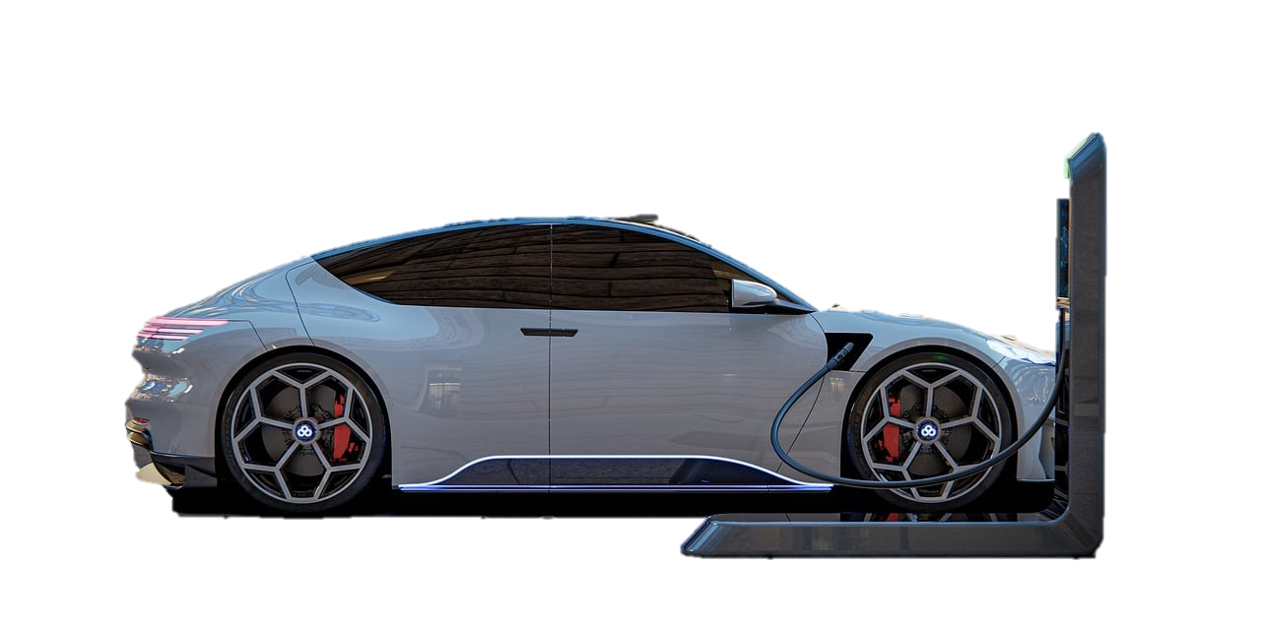
EV MARKET ANALYSIS OF INDIA

Slide 2
EV MARKET ANALYSIS OF INDIA
Presented to : AtliQ Motors Presented by : Jaison Philip

Slide 3
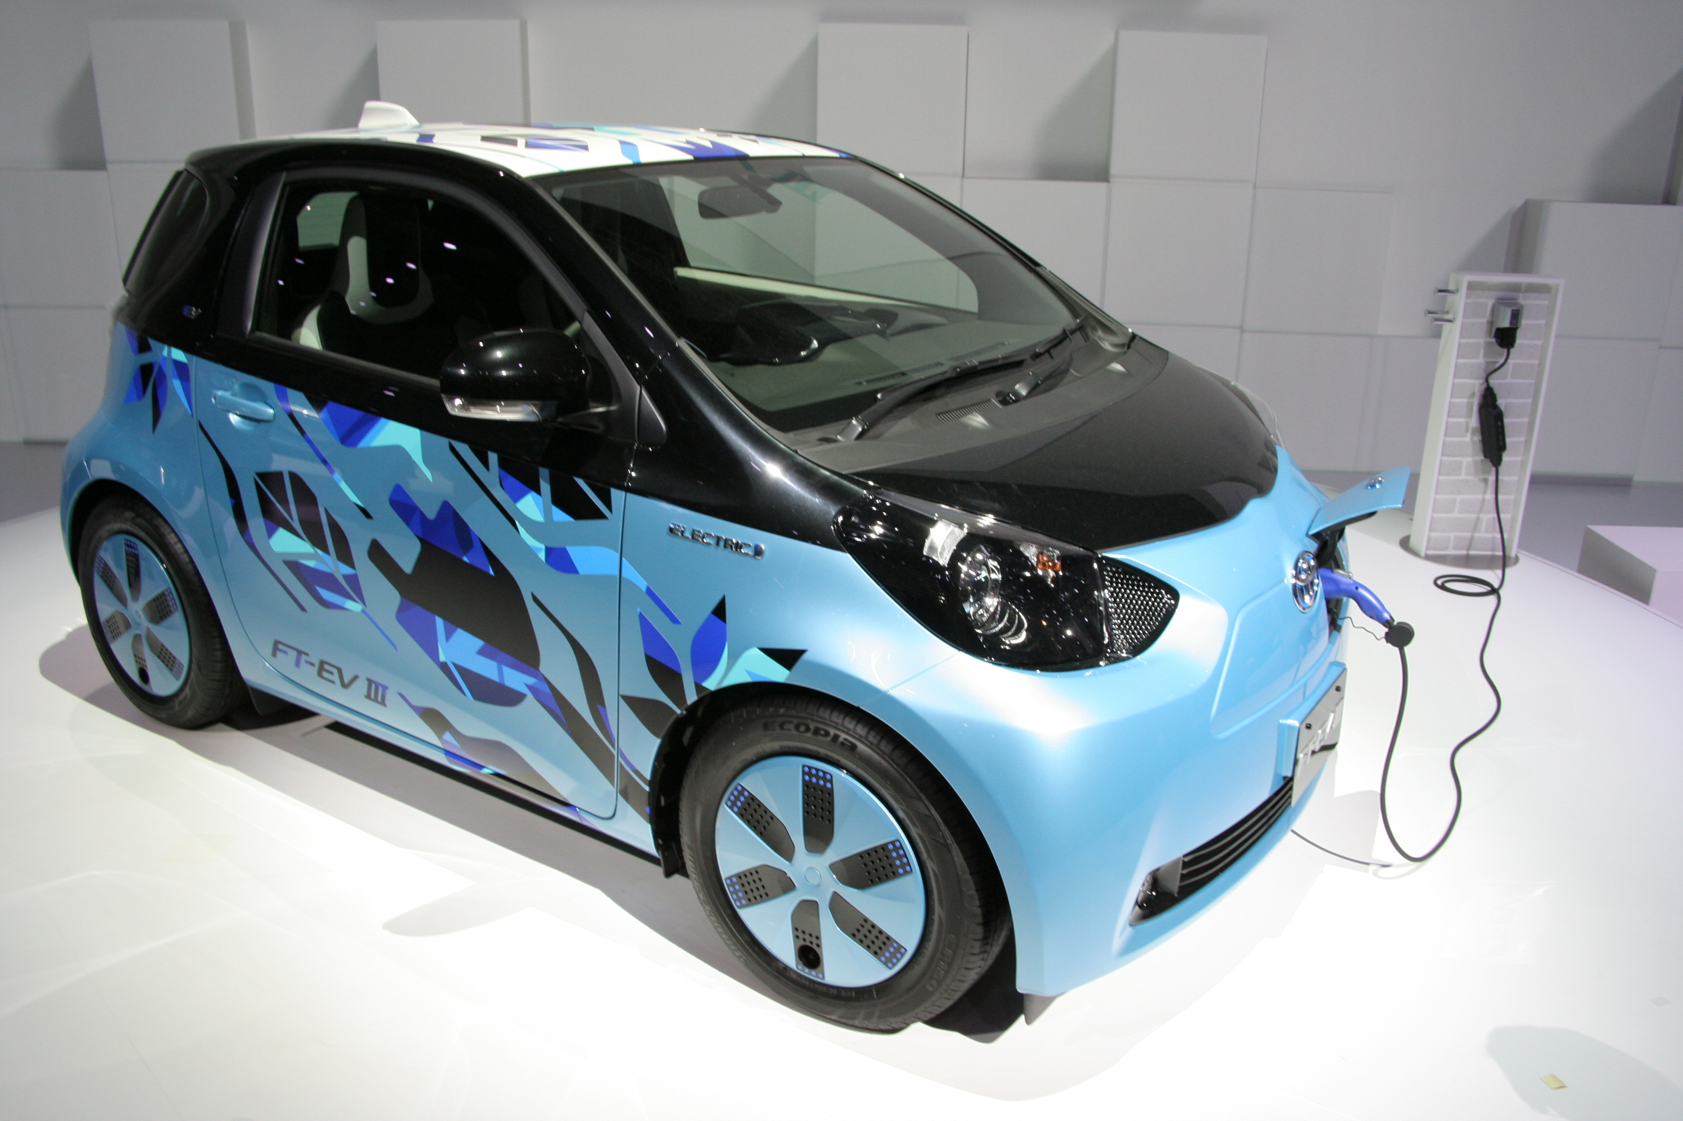
AtliQ Motors
AtliQ Motors is a leading automotive company from the USA, specializing in electric vehicles (EVs). Over the past five years, it has achieved 25% market share in the North American EV & hybrid vehicle segment, positioning itself as an industry leader in sustainable transportation

Slide 4
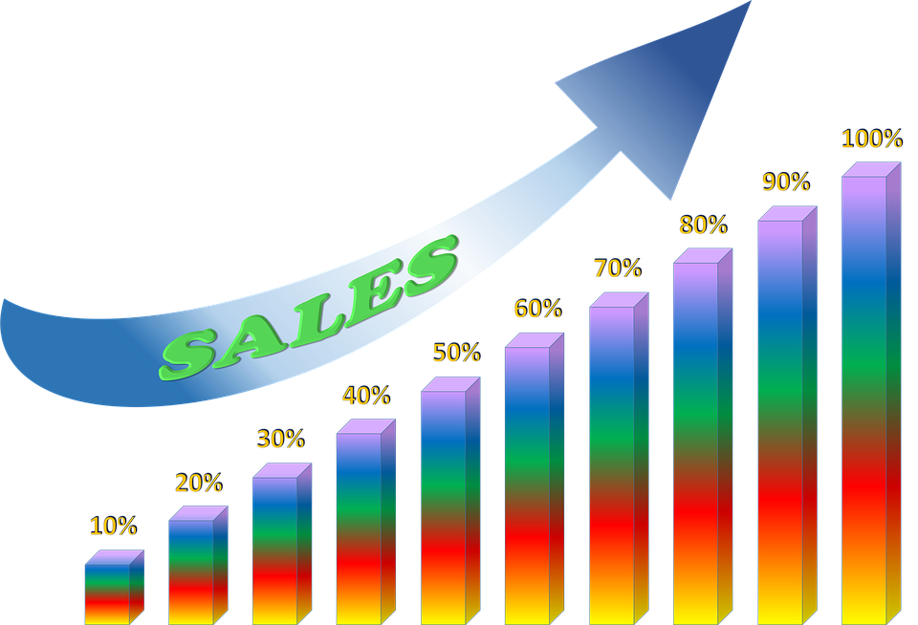
Expansion Plans & Market Potential
As part of its global expansion strategy, AtliQ Motors aims to enter the Indian EV market, where its current market share is less than 2%. With India’s rapid shift towards sustainable mobility and government EV incentives, this expansion presents a high-growth opportunity.

Slide 5

Need for a Market Study
Before launching its bestselling EV models in India, Bruce Haryali, the Chief of AtliQ Motors India, emphasized the need for a detailed market study. Understanding consumer preferences, sales trends, infrastructure challenges, and competitor strategies is crucial for making data-driven decisions.

Slide 6
Preliminary Research Questions

Slide 7
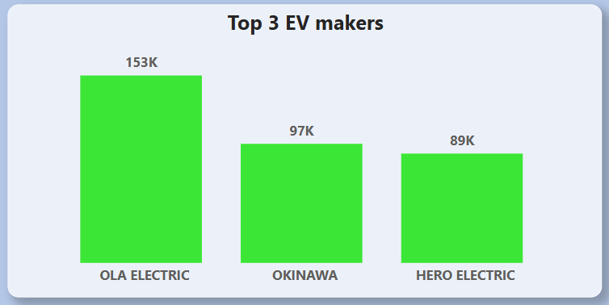
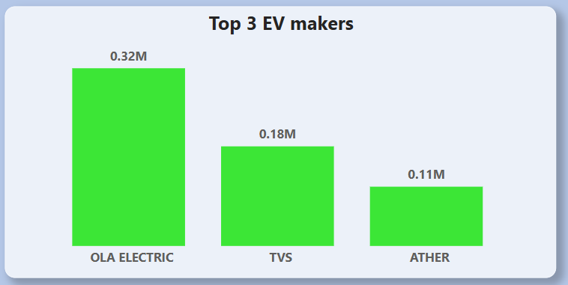
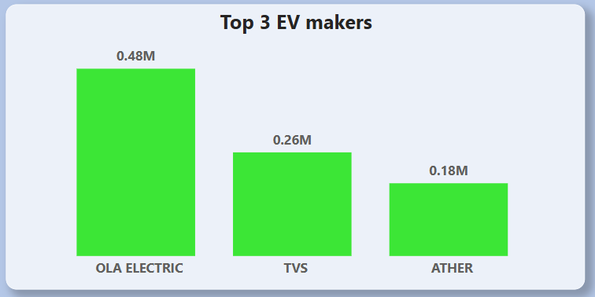
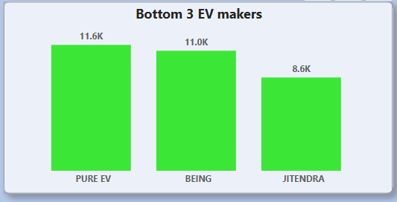
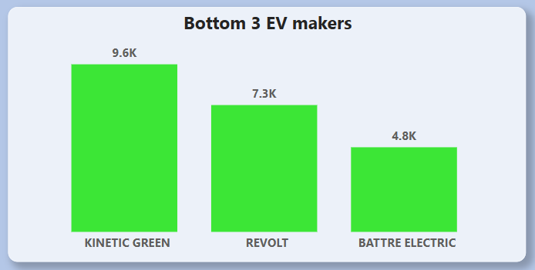
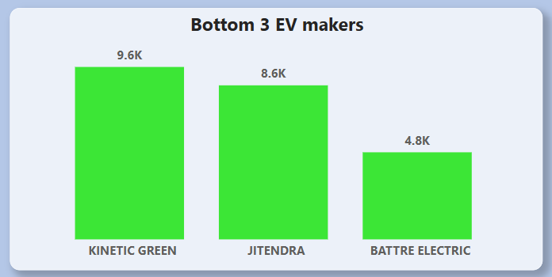
List the top and bottom 3 makers for the fiscal years 2023 and 2024 in terms of the number of 2 – wheelers sold
FY 2023
FY 2024
FY 2023 - 2024

Slide 8
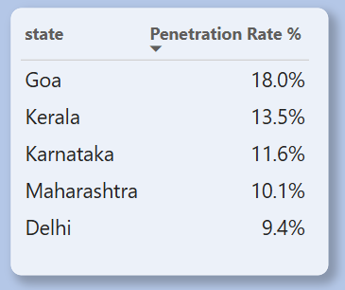
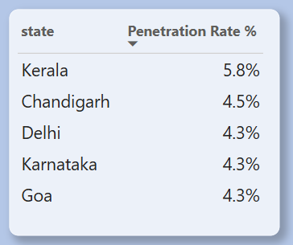
Identify the top 5 states with the highest penetration rate in 2-wheeler and 4-wheeler EV sales in FY 2024.
2 Wheeler
4 Wheeler

Slide 9
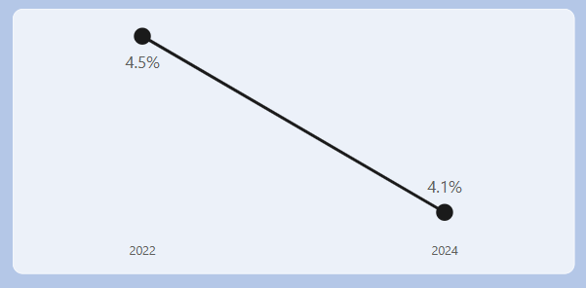
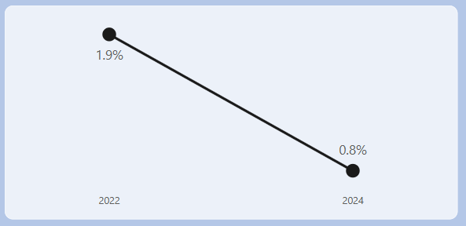
List the states with negative penetration (decline) in EV sales from 2022 to 2024?
Ladakh
Andaman & Nicobar

Slide 10
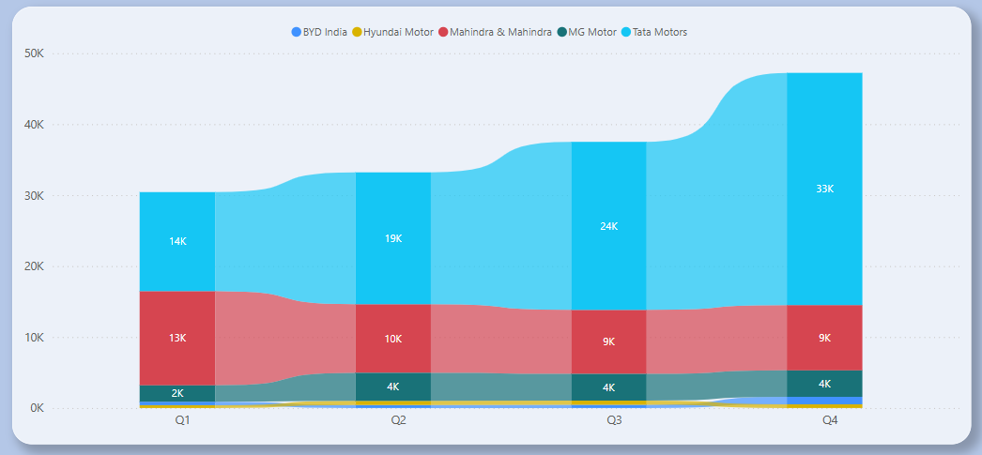
What are the quarterly trends based on sales volume for the top 5 EV makers (4-wheelers) from 2022 to 2024?

Slide 11
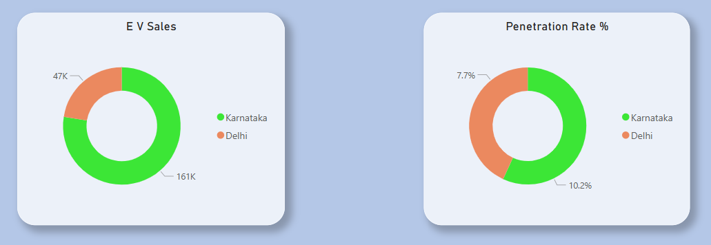
How do the EV sales and penetration rates in Delhi compare to Karnataka for 2024?

Slide 12
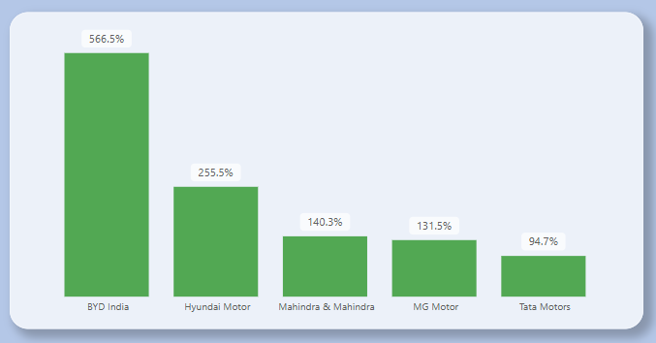
List down the compounded annual growth rate (CAGR) in 4-wheeler units for the top 5 makers from 2022 to 2024.

Slide 13
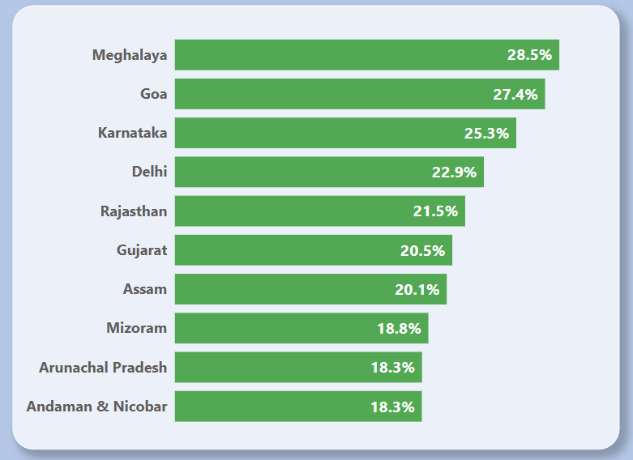
List down the top 10 states that had the highest compounded annual growth rate (CAGR) from 2022 to 2024 in total vehicles sold

Slide 14
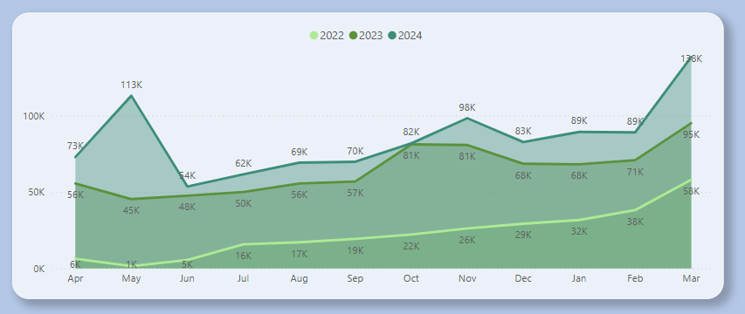
What are the peak and low season months for EV sales based on the data from 2022 to 2024?
March constantly led with highest EV sales from 2022 – 2024
June and July are low seasoned months. May also shown a downfall in 2022 and 2023, but achieved a tremendous growth in 2024

Slide 15
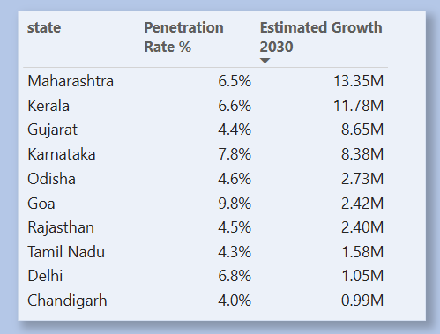
What is the projected number of EV sales (including 2-wheelers and 4 wheelers) for the top 10 states by penetration rate in 2030, based on the compounded annual growth rate (CAGR) from previous years?

Slide 16
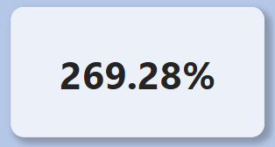
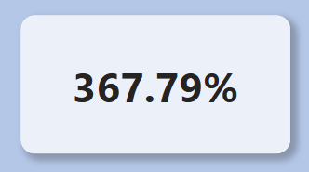
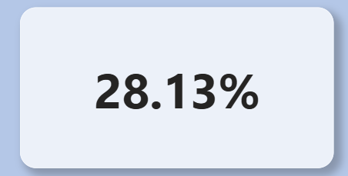
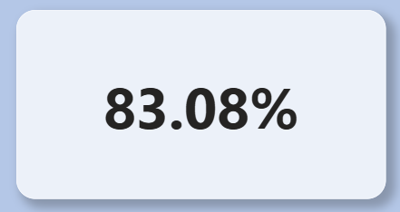
Estimate the revenue growth rate of 4-wheeler and 2-wheelers EVs in India for 2022 vs 2024 and 2023 vs 2024, assuming an average unit price
Revenue Growth 2022 vs 2024
Revenue Growth 2022 vs 2024
Revenue Growth 2023 vs 2024
Revenue Growth 2023 vs 2024
2 – Wheeler
4 – Wheeler

Slide 17
Secondary Research Questions

Slide 18





01
02
04
03
Cost Savings
Government Incentives
Model Availability
Environmental concerns
1
2
3
4
Rising fuel prices and advances in battery technology have made EVs more cost-effective with lower maintenance and longer lifespans.
Government incentives, tax rebates, and reduced fees have significantly lowered EV costs, making them more accessible to buyers
With more EV models available, improved performance, and extended range, EVs now compete strongly with traditional cars.
Rising eco-awareness and government policies on emissions are driving consumers toward cleaner energy vehicles.
Primary reasons for customers choosing 4-wheeler EVs in 2023 and 2024?

Slide 19
02
04
01
03
Government Incentives
Cost Savings
Model Availability
Environmental concerns
1
2
3
4
Government incentives, tax rebates, and reduced fees have significantly lowered EV costs, making them more accessible to buyers
With more EV models available, improved performance, and extended range, EVs now compete strongly with traditional cars.
Rising fuel prices and advances in battery technology have made EVs more cost-effective with lower maintenance and longer lifespans.
Rising eco-awareness and government policies on emissions are driving consumers toward cleaner energy vehicles.
Primary reasons for customers choosing 4-wheeler EVs in 2023 and 2024?

Slide 20
02
04
01
03
Government Incentives
Model Availability
Cost Savings
Environmental concerns
1
2
3
4
Government incentives, tax rebates, and reduced fees have significantly lowered EV costs, making them more accessible to buyers
With more EV models available, improved performance, and extended range, EVs now compete strongly with traditional cars.
Rising fuel prices and advances in battery technology have made EVs more cost-effective with lower maintenance and longer lifespans.
Rising eco-awareness and government policies on emissions are driving consumers toward cleaner energy vehicles.
Primary reasons for customers choosing 4-wheeler EVs in 2023 and 2024?

Slide 21
02
01
03
04
Government Incentives
Model Availability
Cost Savings
Environmental concerns
1
2
3
4
Government incentives, tax rebates, and reduced fees have significantly lowered EV costs, making them more accessible to buyers
Rising fuel prices and advances in battery technology have made EVs more cost-effective with lower maintenance and longer lifespans.
Rising eco-awareness and government policies on emissions are driving consumers toward cleaner energy vehicles.
With more EV models available, improved performance, and extended range, EVs now compete strongly with traditional cars.
Primary reasons for customers choosing 4-wheeler EVs in 2023 and 2024?

Slide 22
02
04
01
03
Government Incentives
Cost Savings
Model Availability
Environmental concerns
1
2
3
4
Government incentives, tax rebates, and reduced fees have significantly lowered EV costs, making them more accessible to buyers
With more EV models available, improved performance, and extended range, EVs now compete strongly with traditional cars.
Rising fuel prices and advances in battery technology have made EVs more cost-effective with lower maintenance and longer lifespans.
Rising eco-awareness and government policies on emissions are driving consumers toward cleaner energy vehicles.
Primary reasons for customers choosing 4-wheeler EVs in 2023 and 2024?

Slide 23
01
02
Two wheelers
Four wheelers
1
2
The central government has extended Electric Mobility Promotion Scheme 2024 until Sep 30, 2024. This scheme offers subsidies up to 10,000 INR for electric two wheelers
FAME II scheme provides subsidy benefit up to 15,000 per kilowatt (KWh) capped up to 40 % of ex – showroom price
FAME II scheme also supports four wheelers
State level subsidies vary across India. States like Maharashtra, Karnataka, Delhi have been in front of providing incentives of EV purchase
Impact of government incentives and subsidies in the adoption rates of 2-wheelers and 4-wheelers

Slide 24
01
02
Two wheelers
Four wheelers
1
2
The central government has extended Electric Mobility Promotion Scheme 2024 until Sep 30, 2024. This scheme offers subsidies up to 10,000 INR for electric two wheelers
FAME II scheme provides subsidy benefit up to 15,000 per kilowatt (KWh) capped up to 40 % of ex – showroom price
FAME II scheme also supports four wheelers
State level subsidies vary across India. States like Maharashtra, Karnataka, Delhi have been in front of providing incentives of EV purchase
Impact of government incentives and subsidies in the adoption rates of 2-wheelers and 4-wheelers

Slide 25
01
02
Two wheelers
Four wheelers
1
2
The central government has extended Electric Mobility Promotion Scheme 2024 until Sep 30, 2024. This scheme offers subsidies up to 10,000 INR for electric two wheelers
FAME II scheme provides subsidy benefit up to 15,000 per kilowatt (KWh) capped up to 40 % of ex – showroom price
FAME II scheme also supports four wheelers
State level subsidies vary across India. States like Maharashtra, Karnataka, Delhi have been in front of providing incentives of EV purchase
Impact of government incentives and subsidies in the adoption rates of 2-wheelers and 4-wheelers

Slide 26
Charging station availability corelate with EV sales and Penetration Rate.
Kerala and Maharashtra have high sales and penetration rates and they have significant number of charging stations
Even with few charging stations, Karnataka also have a large number of sales and penetration rate indicating that supportive policies and incentives can also boost EV sales
How does the availability of charging stations infrastructure correlate with the EV sales and penetration rates

Slide 27
Charging station availability corelate with EV sales and Penetration Rate.
Kerala and Maharashtra have high sales and penetration rates and they have significant number of charging stations
Even with few charging stations, Karnataka also have a large number of sales and penetration rate indicating that supportive policies and incentives can also boost EV sales
How does the availability of charging stations infrastructure correlate with the EV sales and penetration rates

Slide 28
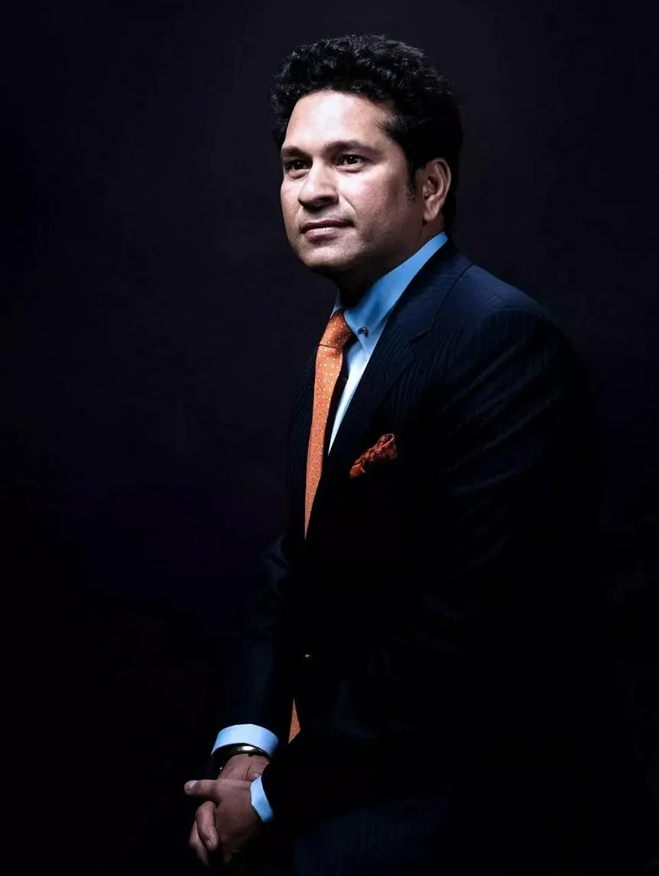
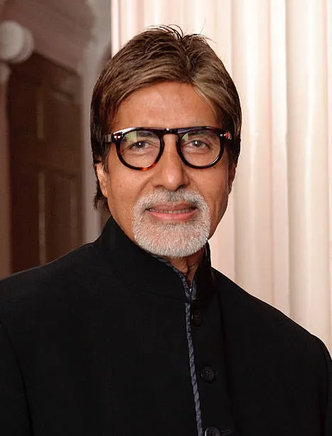
01
02
Sachin Tendulkar
Amitabh Bachchan
1
2
Iconic cricketer with massive public influence.
Can inspire millions to adopt EVs for a better future
Trusted and respected figure across all age groups
Legendary actor with a vast fan following across generations
Highly respected and credible public figure.
Known for supporting social and environmental causes.
Who should be the brand ambassador if AtliQ Motors launches their EV/Hybrid vehicles in India and why?

Slide 29
01
02
Sachin Tendulkar
Amitabh Bachchan
1
2
Iconic cricketer with massive public influence.
Can inspire millions to adopt EVs for a better future
Trusted and respected figure across all age groups
Legendary actor with a vast fan following across generations
Highly respected and credible public figure.
Known for supporting social and environmental causes.
Who should be the brand ambassador if AtliQ Motors launches their EV/Hybrid vehicles in India and why?

Slide 30
01
02
Sachin Tendulkar
Amitabh Bachchan
1
2
Iconic cricketer with massive public influence.
Can inspire millions to adopt EVs for a better future
Trusted and respected figure across all age groups
Legendary actor with a vast fan following across generations
Highly respected and credible public figure.
Known for supporting social and environmental causes.
Who should be the brand ambassador if AtliQ Motors launches their EV/Hybrid vehicles in India and why?

Slide 31
GUJARAT
Strategic Location – Proximity to ports (e.g., Mundra, Kandla) ensures smooth import/export of raw materials and finished vehicles.
Strong Industrial Ecosystem – Presence of major automobile manufacturers and a well-developed supplier network.
Business-Friendly Policies – Supportive state government policies, tax benefits, and incentives for manufacturing units.
Which state of India is ideal to start the manufacturing unit?

Slide 32
GUJARAT
Strategic Location – Proximity to ports (e.g., Mundra, Kandla) ensures smooth import/export of raw materials and finished vehicles.
Strong Industrial Ecosystem – Presence of major automobile manufacturers and a well-developed supplier network.
Business-Friendly Policies – Supportive state government policies, tax benefits, and incentives for manufacturing units.
Which state of India is ideal to start the manufacturing unit?

Slide 33
01
02
03
High Penetration States
Exciting Offers
Infrastructure Development
1
2
3
Begin launching vehicles in states that have both a high EV penetration rate and a strong year-over-year growth trend.
This strategy ensures a ready market with existing EV adoption while capitalizing on regions with increasing demand for electric vehicles.
Launch with exciting offers on batteries and after-sales services to attract more customers.
Providing competitive deals on battery replacements, extended warranties, and maintenance services will enhance customer trust and drive higher adoption rates.
For long-term growth, it is essential to invest in expanding charging infrastructure to support the increasing number of EV users.
Additionally, improving other key infrastructures will enhance accessibility and accelerate the adoption of electric vehicles.
Top 3 recommendations for AtliQ Motors

Slide 34
01
02
03
High Penetration States
Exciting Offers
Infrastructure Development
1
Begin launching vehicles in states that have both a high EV penetration rate and a strong year-over-year growth trend.
This strategy ensures a ready market with existing EV adoption while capitalizing on regions with increasing demand for electric vehicles.
2
3
Launch with exciting offers on batteries and after-sales services to attract more customers.
Providing competitive deals on battery replacements, extended warranties, and maintenance services will enhance customer trust and drive higher adoption rates.
For long-term growth, it is essential to invest in expanding charging infrastructure to support the increasing number of EV users.
Additionally, improving other key infrastructures will enhance accessibility and accelerate the adoption of electric vehicles.
Top 3 recommendations for AtliQ Motors

Slide 35
01
02
03
High Penetration States
Exciting Offers
Infrastructure Development
1
2
Begin launching vehicles in states that have both a high EV penetration rate and a strong year-over-year growth trend.
This strategy ensures a ready market with existing EV adoption while capitalizing on regions with increasing demand for electric vehicles.
Launch with exciting offers on batteries and after-sales services to attract more customers.
Providing competitive deals on battery replacements, extended warranties, and maintenance services will enhance customer trust and drive higher adoption rates.
3
For long-term growth, it is essential to invest in expanding charging infrastructure to support the increasing number of EV users.
Additionally, improving other key infrastructures will enhance accessibility and accelerate the adoption of electric vehicles.
Top 3 recommendations for AtliQ Motors

Slide 36
01
02
03
High Penetration States
Exciting Offers
Infrastructure Development
1
2
3
Begin launching vehicles in states that have both a high EV penetration rate and a strong year-over-year growth trend.
This strategy ensures a ready market with existing EV adoption while capitalizing on regions with increasing demand for electric vehicles.
Launch with exciting offers on batteries and after-sales services to attract more customers.
Providing competitive deals on battery replacements, extended warranties, and maintenance services will enhance customer trust and drive higher adoption rates.
For long-term growth, it is essential to invest in expanding charging infrastructure to support the increasing number of EV users.
Additionally, improving other key infrastructures will enhance accessibility and accelerate the adoption of electric vehicles.
Top 3 recommendations for AtliQ Motors

Slide 37
THANK YOU

